Slide 1
Golden Gate Assembly Methods
By Corinne Andresen and Annie Wacker

Slide 2
Goal: To streamline the protocol for use in teaching labs

Slide 3
Golden Gate Assembly
DNA: plasmid J119044 (044)+ insert sources:
J119022 (022) cloned promoter
PCR product
annealed oligos
Ligation Protocol
BsaI + ligase
37° C for 1 minute
16° C for 1 minute
Total of 5, 10, 20, or 30 cycles
37° C for 15 minutes

Slide 4
Plasmid-Plasmid Exchange
Bsa I
T T
Bsa I
J119044 plasmid
gene
Bsa I
Bsa I
J119022 plasmid

Slide 5
Plasmid-Plasmid Exchange
Bsa I
TT
Bsa I
J119044 plasmid
RBS
Bsa I
Bsa I
J119022 plasmid

Slide 6
Plasmid-Plasmid Exchange
Bsa I
T T
Bsa I
J119044 plasmid
gene
+ Bsa I and ligase
Bsa I
Bsa I
J119022 plasmid

Slide 7
Plasmid-Plasmid Exchange
Bsa I
T T
Bsa I
gene
recombinant plasmid
gene
Bsa I
Bsa I

Slide 8
Raw PCR Product Method
Bsa I
T T
Bsa I
J119044 plasmid
gene
+ Bsa I and ligase
Bsa I
Bsa I
J119022
PCR product

Slide 9
Raw PCR Product Method
recombinant plasmid
gene

Slide 10
Cleaned PCR Product Method
Bsa I
T T
Bsa I
J119044 plasmid
gene
Bsa I
Bsa I
J119022
PCR product

Slide 11
Cleaned PCR Product Method
Bsa I
T T
Bsa I
J119044 plasmid
gene
+ Bsa I and ligase
primers
dNTPs
buffer
polymerase
Bsa I
Bsa I
J119022
PCR products

Slide 12
Cleaned PCR Product Method
recombinant plasmid
gene

Slide 13
Simple Oligo Method
Bsa I
Bsa I

Slide 14
Simple Oligo Method
Bsa I
T T
Bsa I
J119044 plasmid
gene
+ Bsa I and ligase
Bsa I
Bsa I
J119022 insert: annealed oligos

Slide 15
Simple Oligo Method
recombinant plasmid
gene

Slide 16
Complex Oligo Method
Bsa I
Bsa I

Slide 17
Complex Oligo Method
Bsa I
T T
Bsa I
J119044 plasmid
gene
+ Bsa I and ligase
Bsa I
Bsa I
pLacI promoter: annealed oligos

Slide 18
Complex Oligo Method
recombinant plasmid
gene

Slide 19
Recombinant Plasmid to RFP
gene

Slide 20
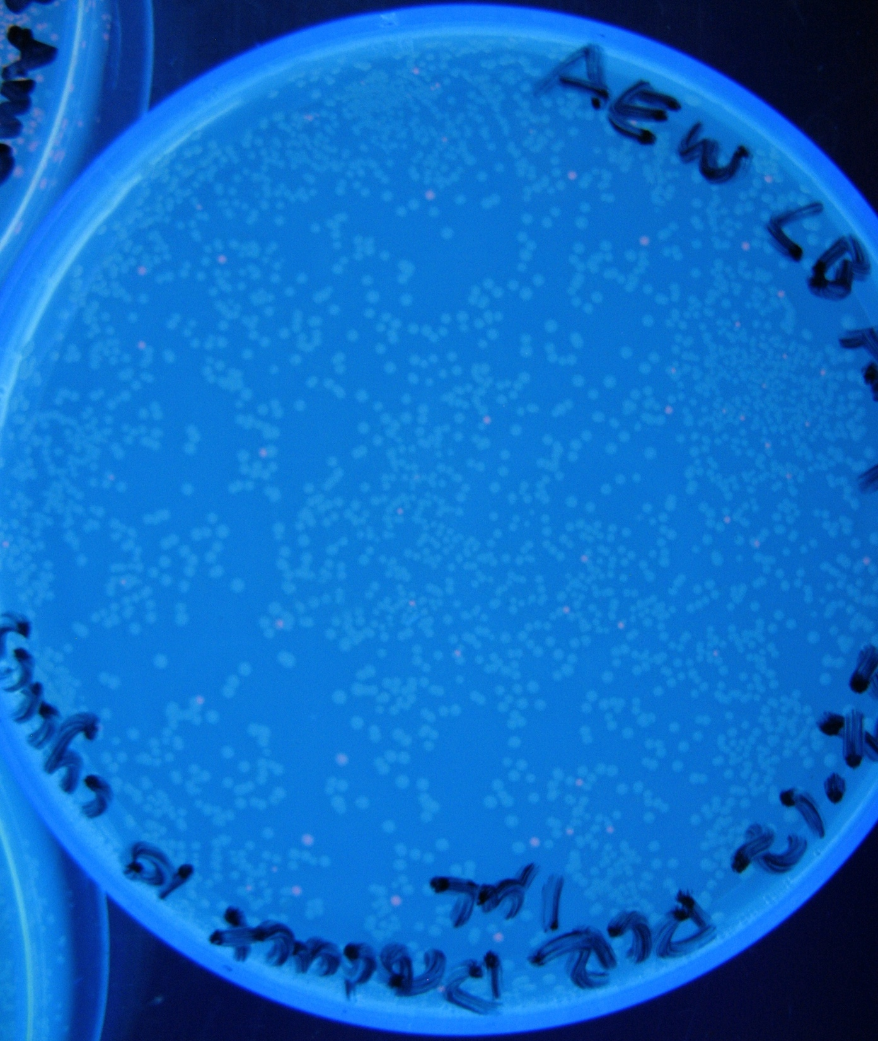
Raw PCR Product Method
trace red colonies

Slide 21
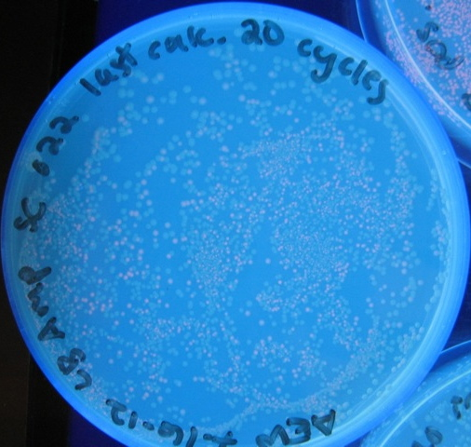
Cleaned Oligo Method
30% red
colonies

Slide 22
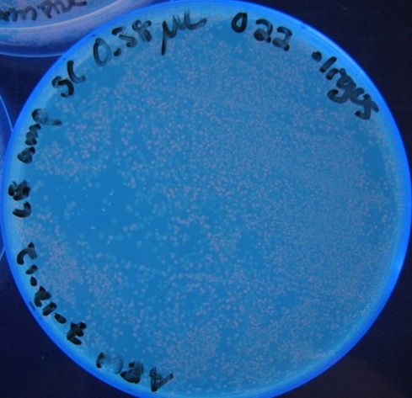
Cleaned Oligo Method
50% red
colonies

Slide 23
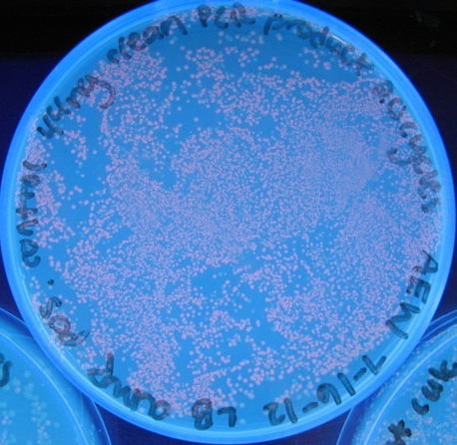
Cleaned PCR Product Method
90% red
colonies

Slide 24
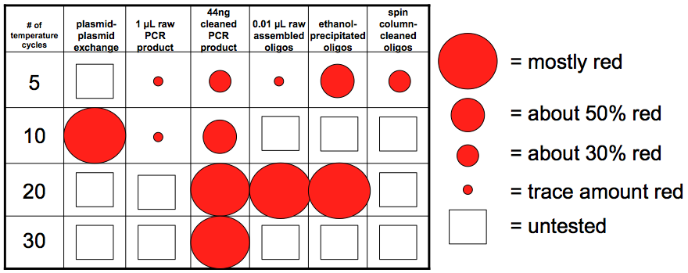
What is the best way to do this?

Slide 25
Other Variables
Oligos with Bsa I sites instead of sticky ends
Different oligo:plasmid ratios
Master mix without KOAc
Presence of other plasmids
Robustness of the master mix

Slide 26
Are Restriction Sites Necessary?
Bsa I
Bsa I
vs.
sticky end #1
sticky end #2

Slide 27
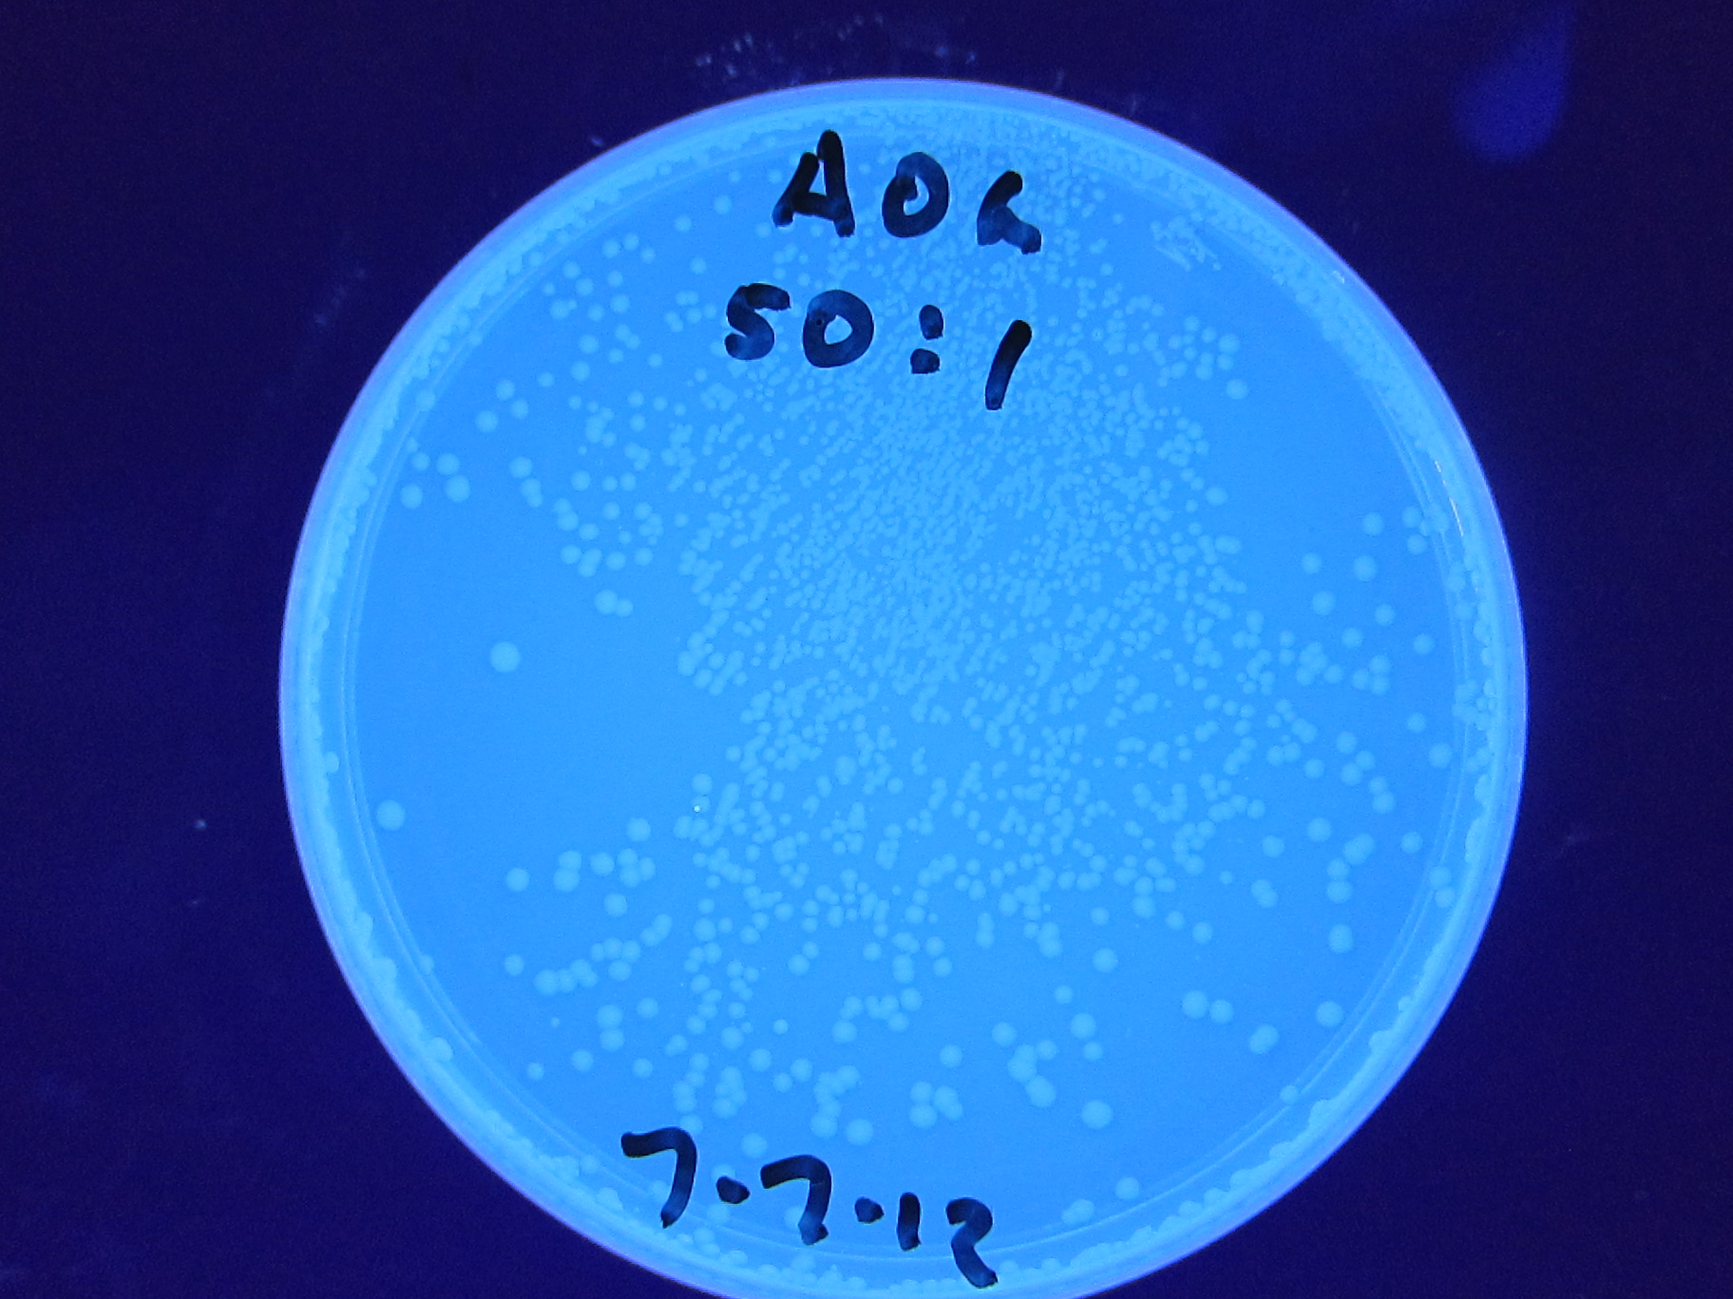
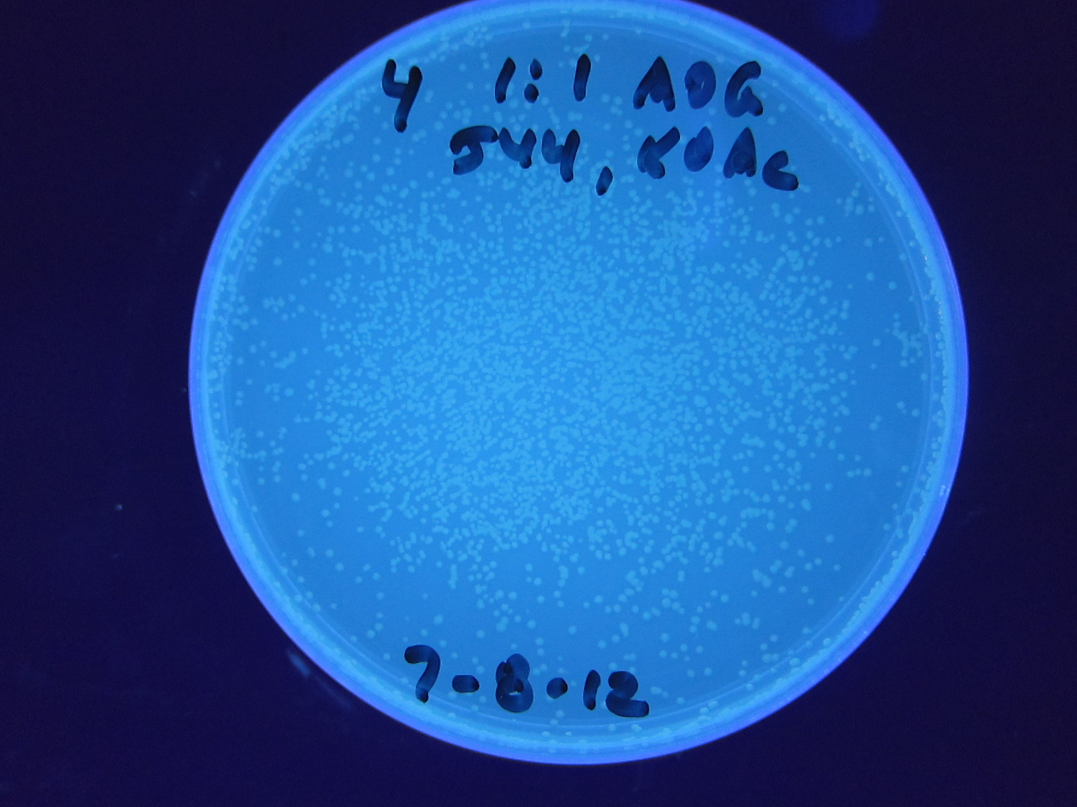
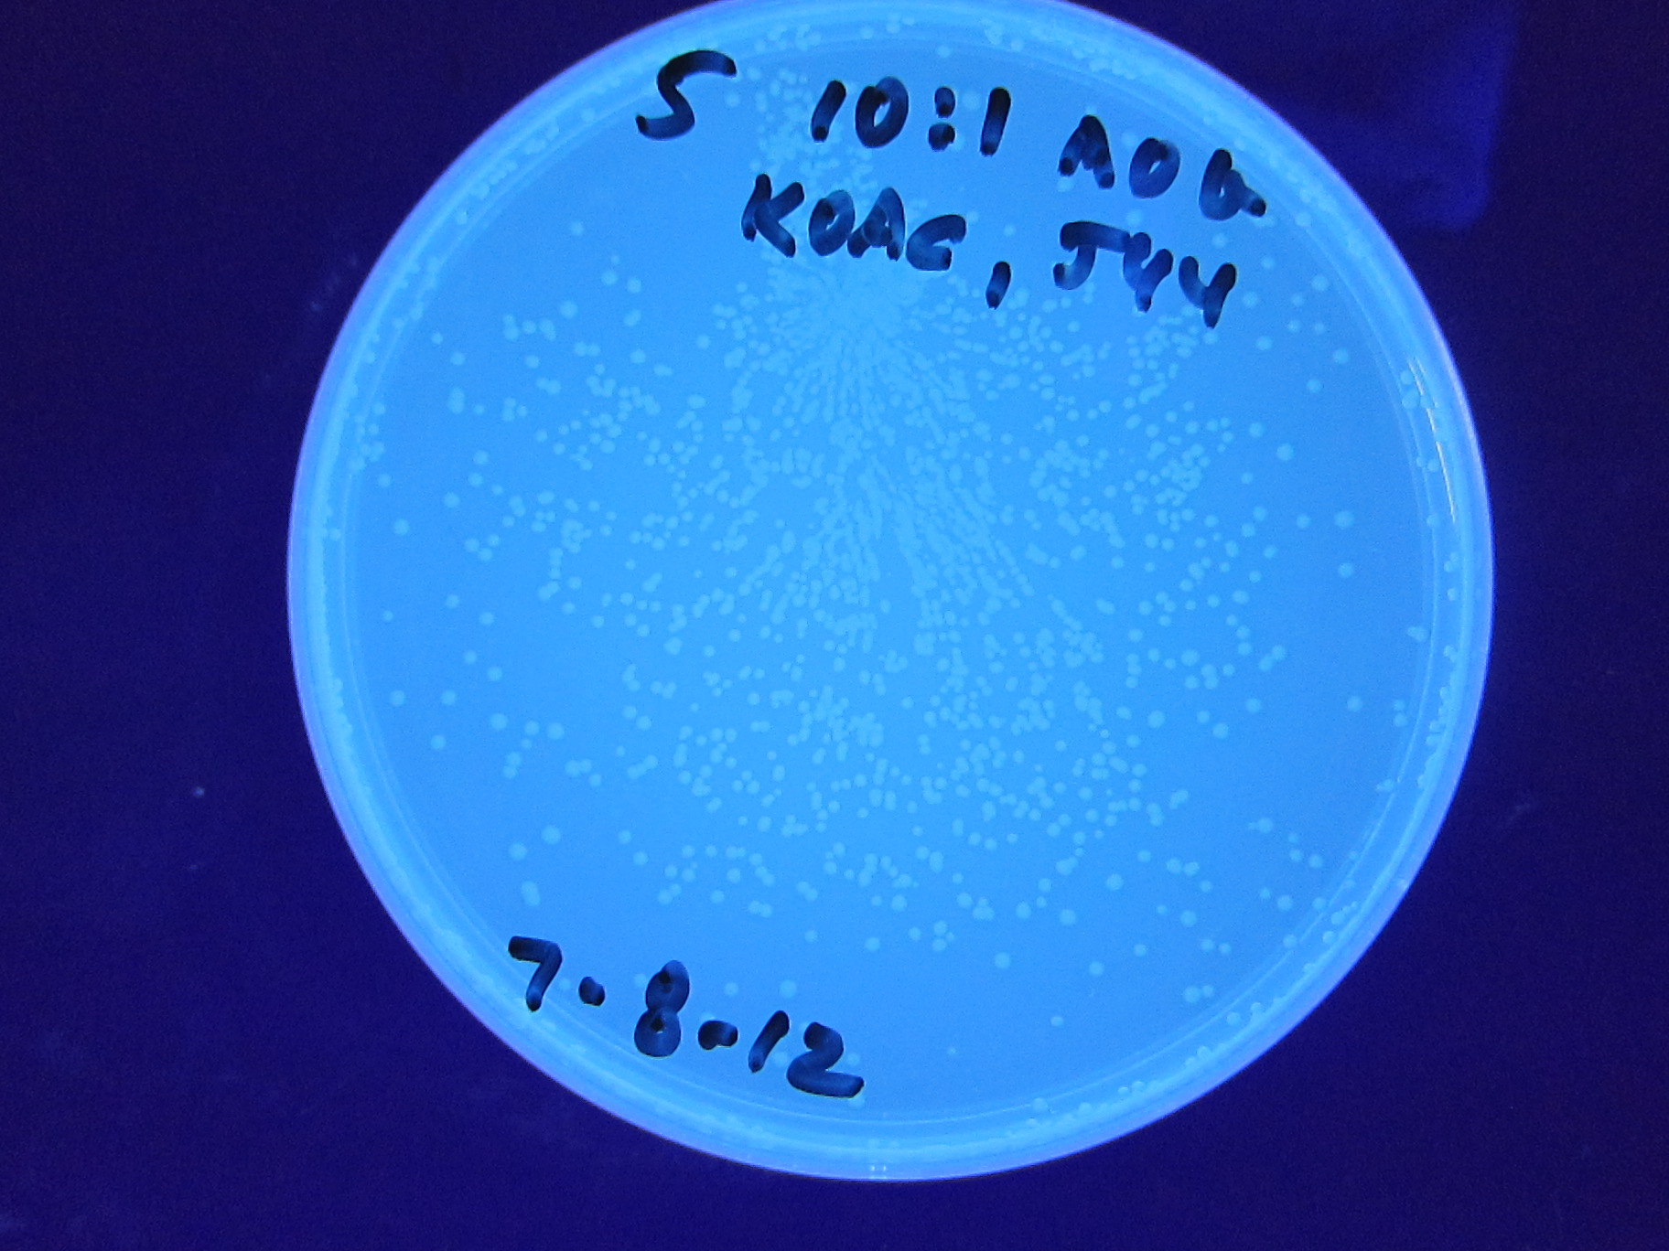
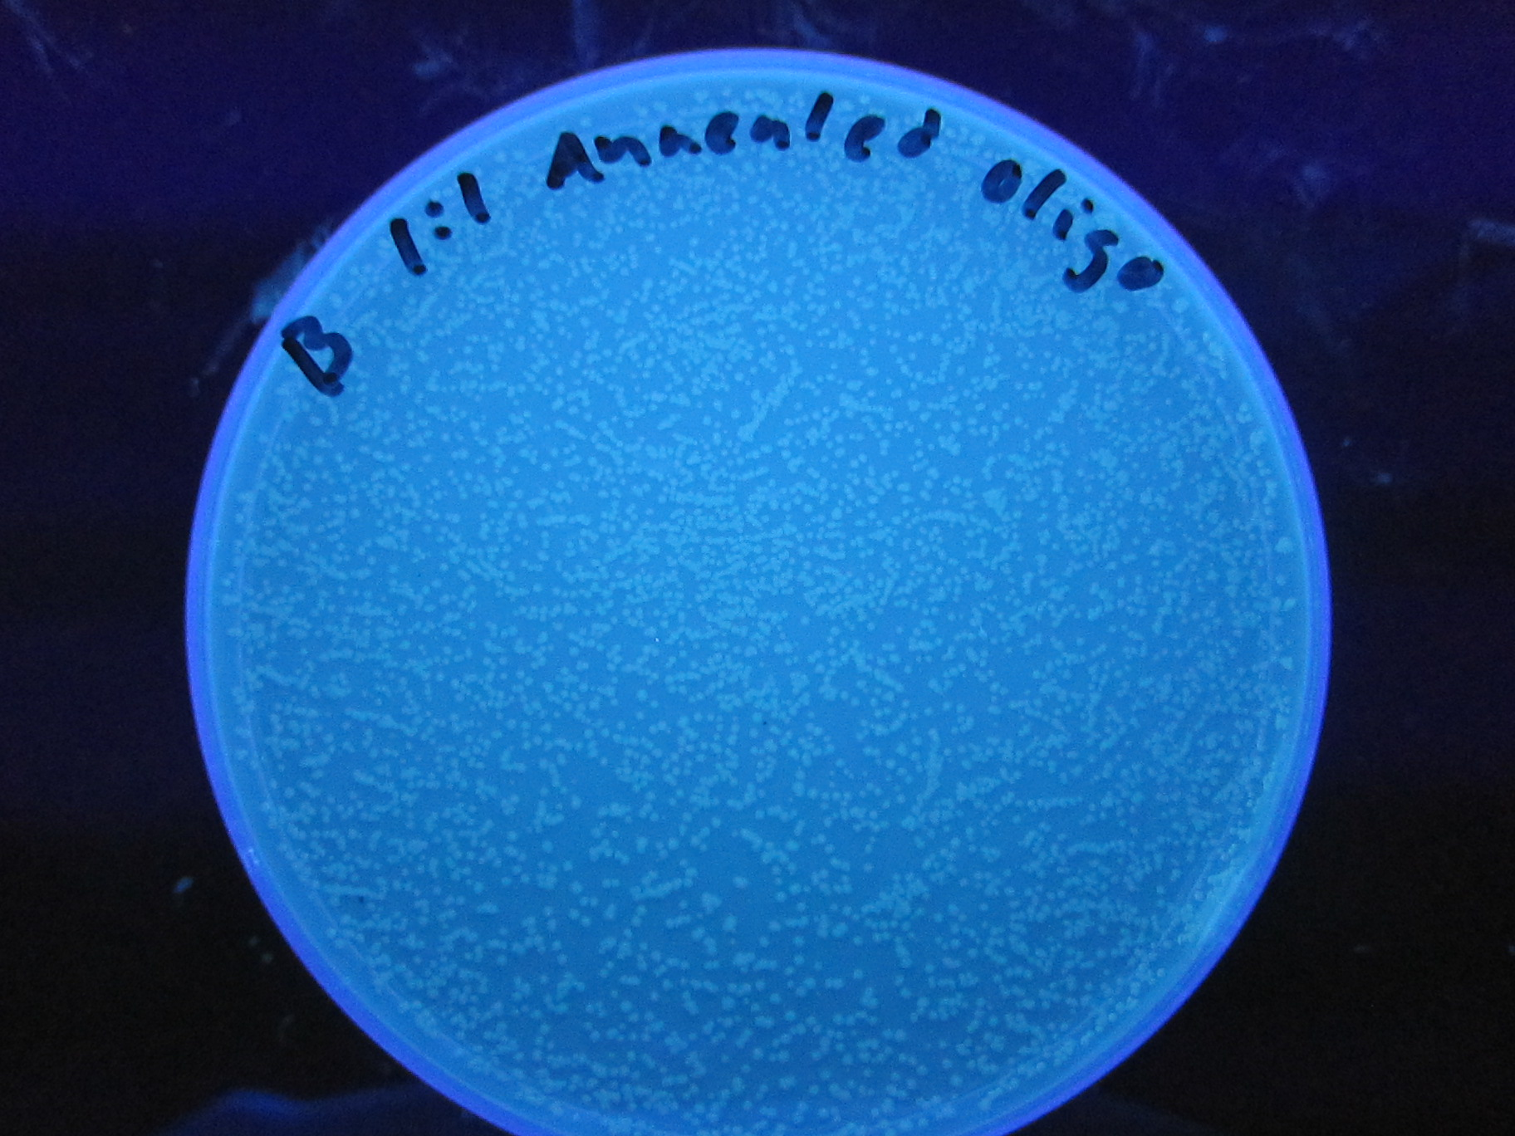
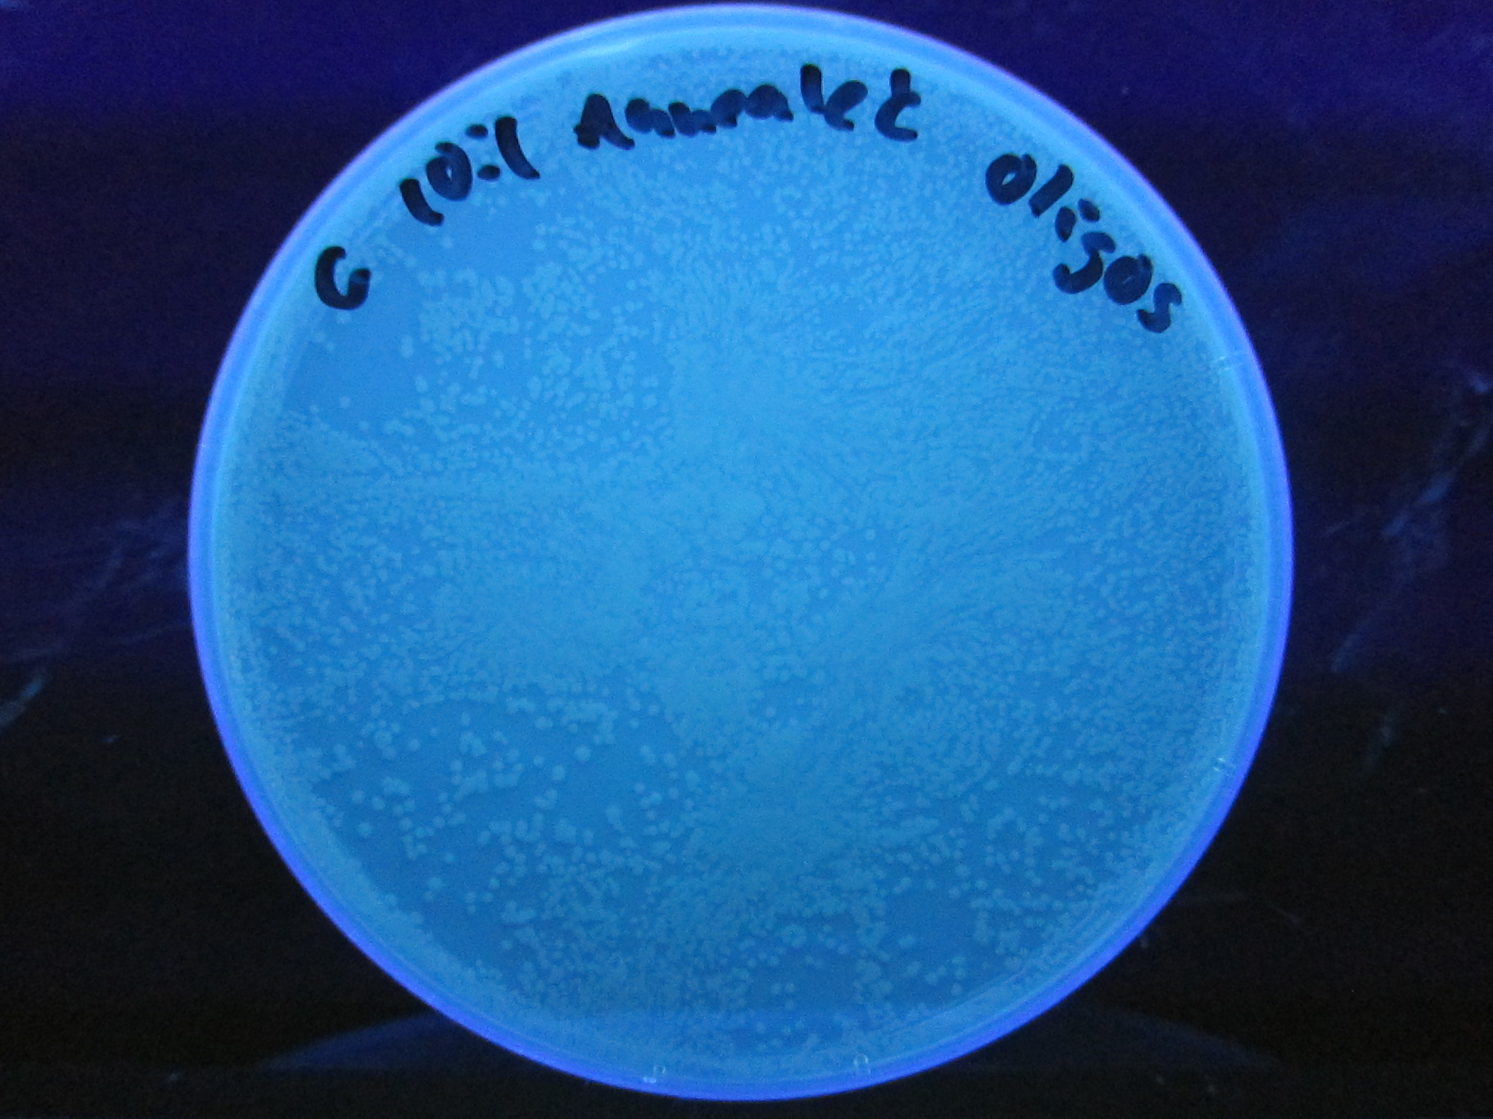
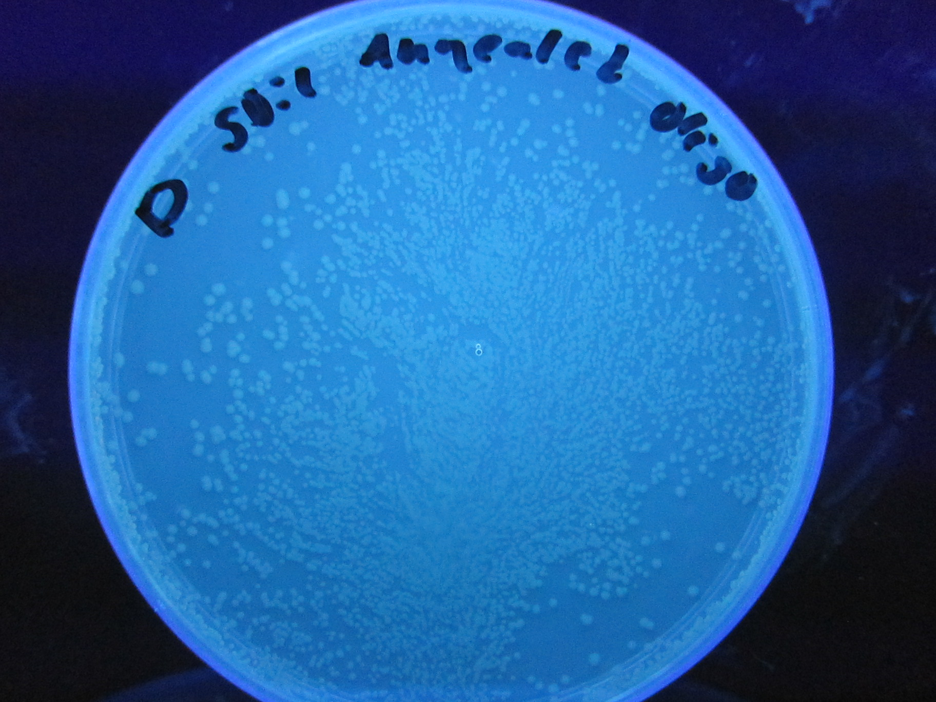
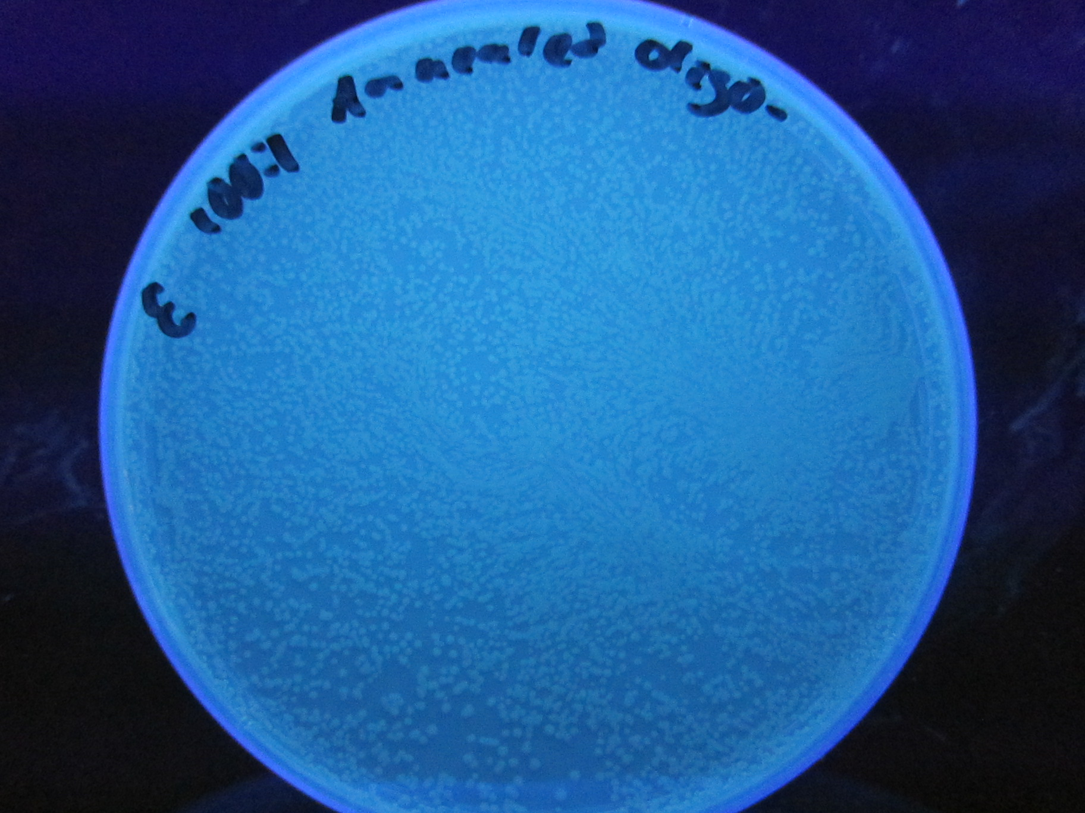
Different Ratios of Oligos

Slide 28
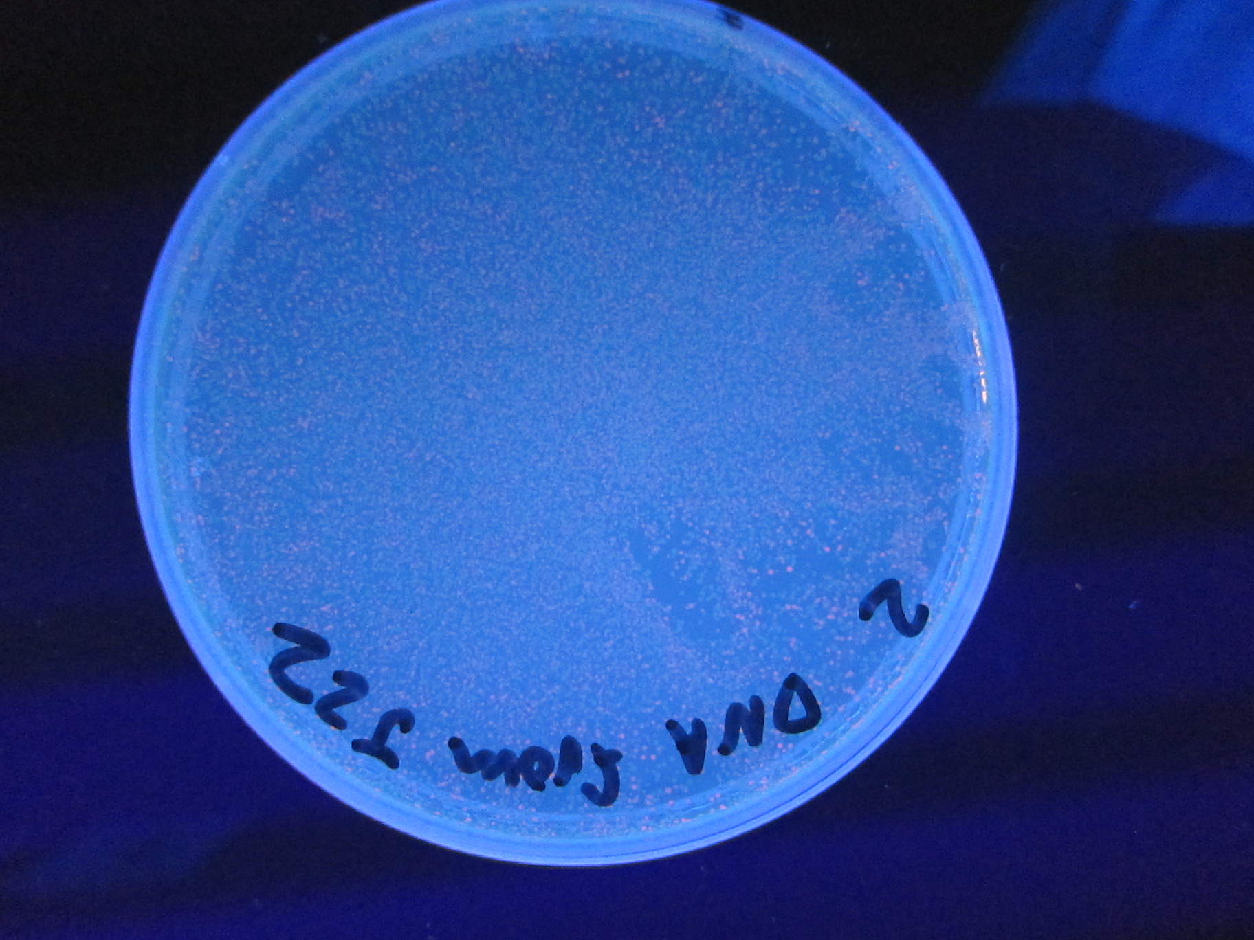
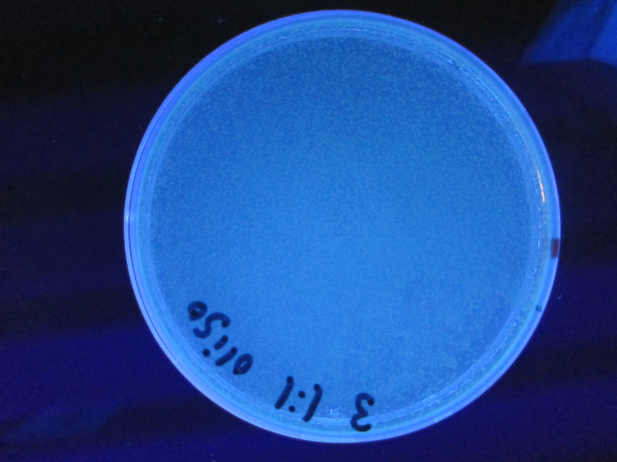
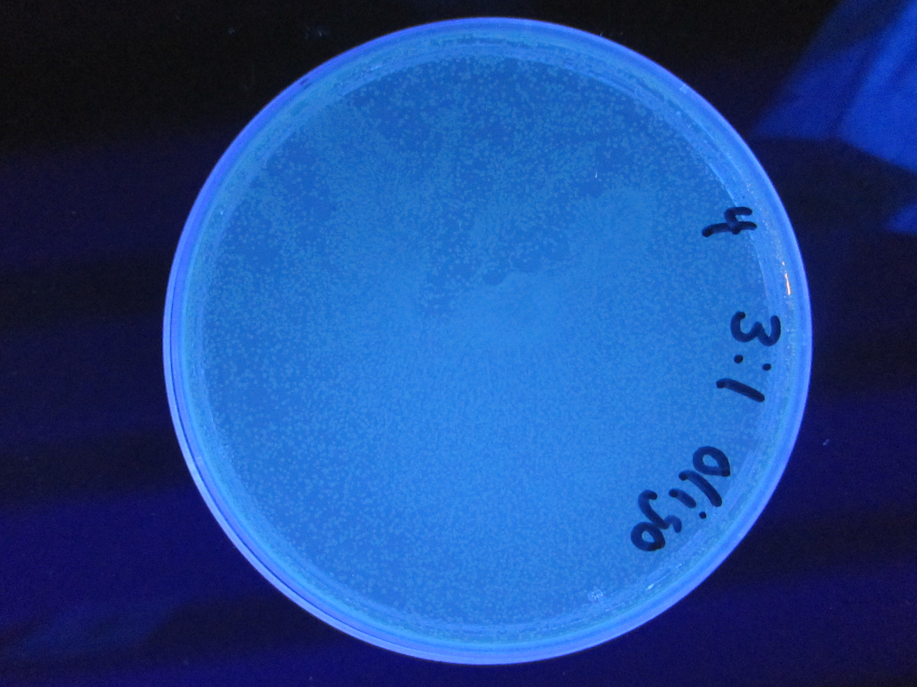
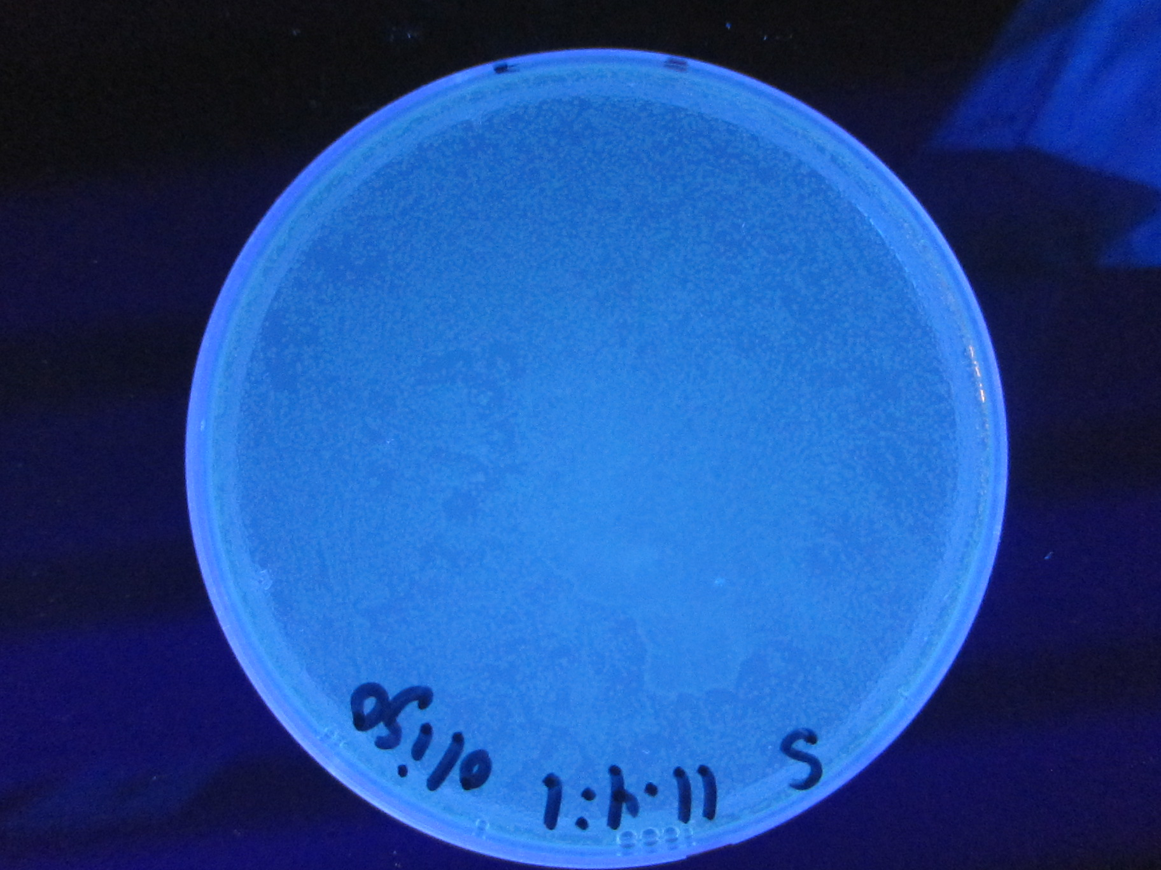
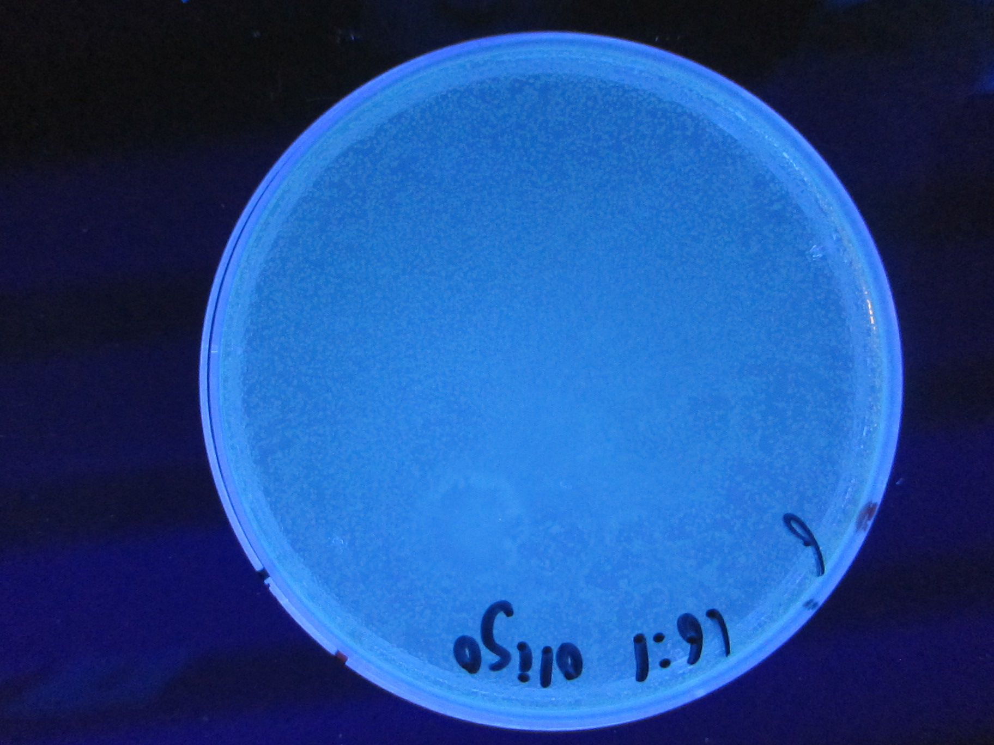
Using Annie’s Work As a Control

Slide 29
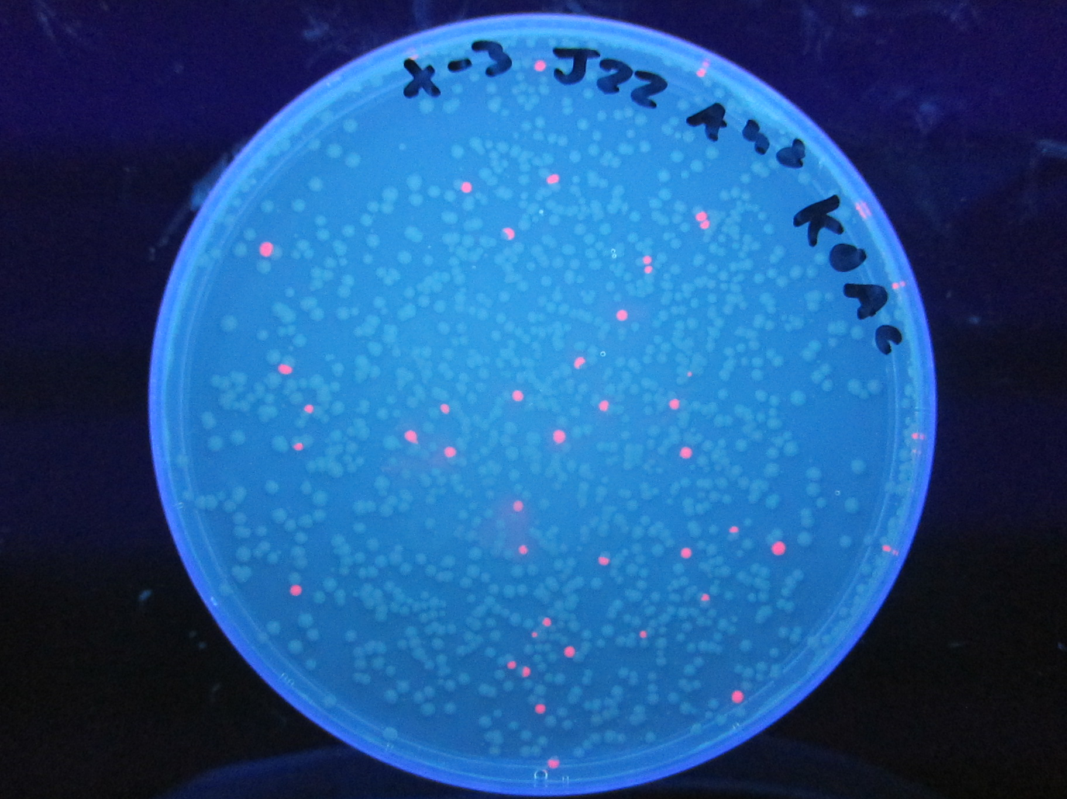
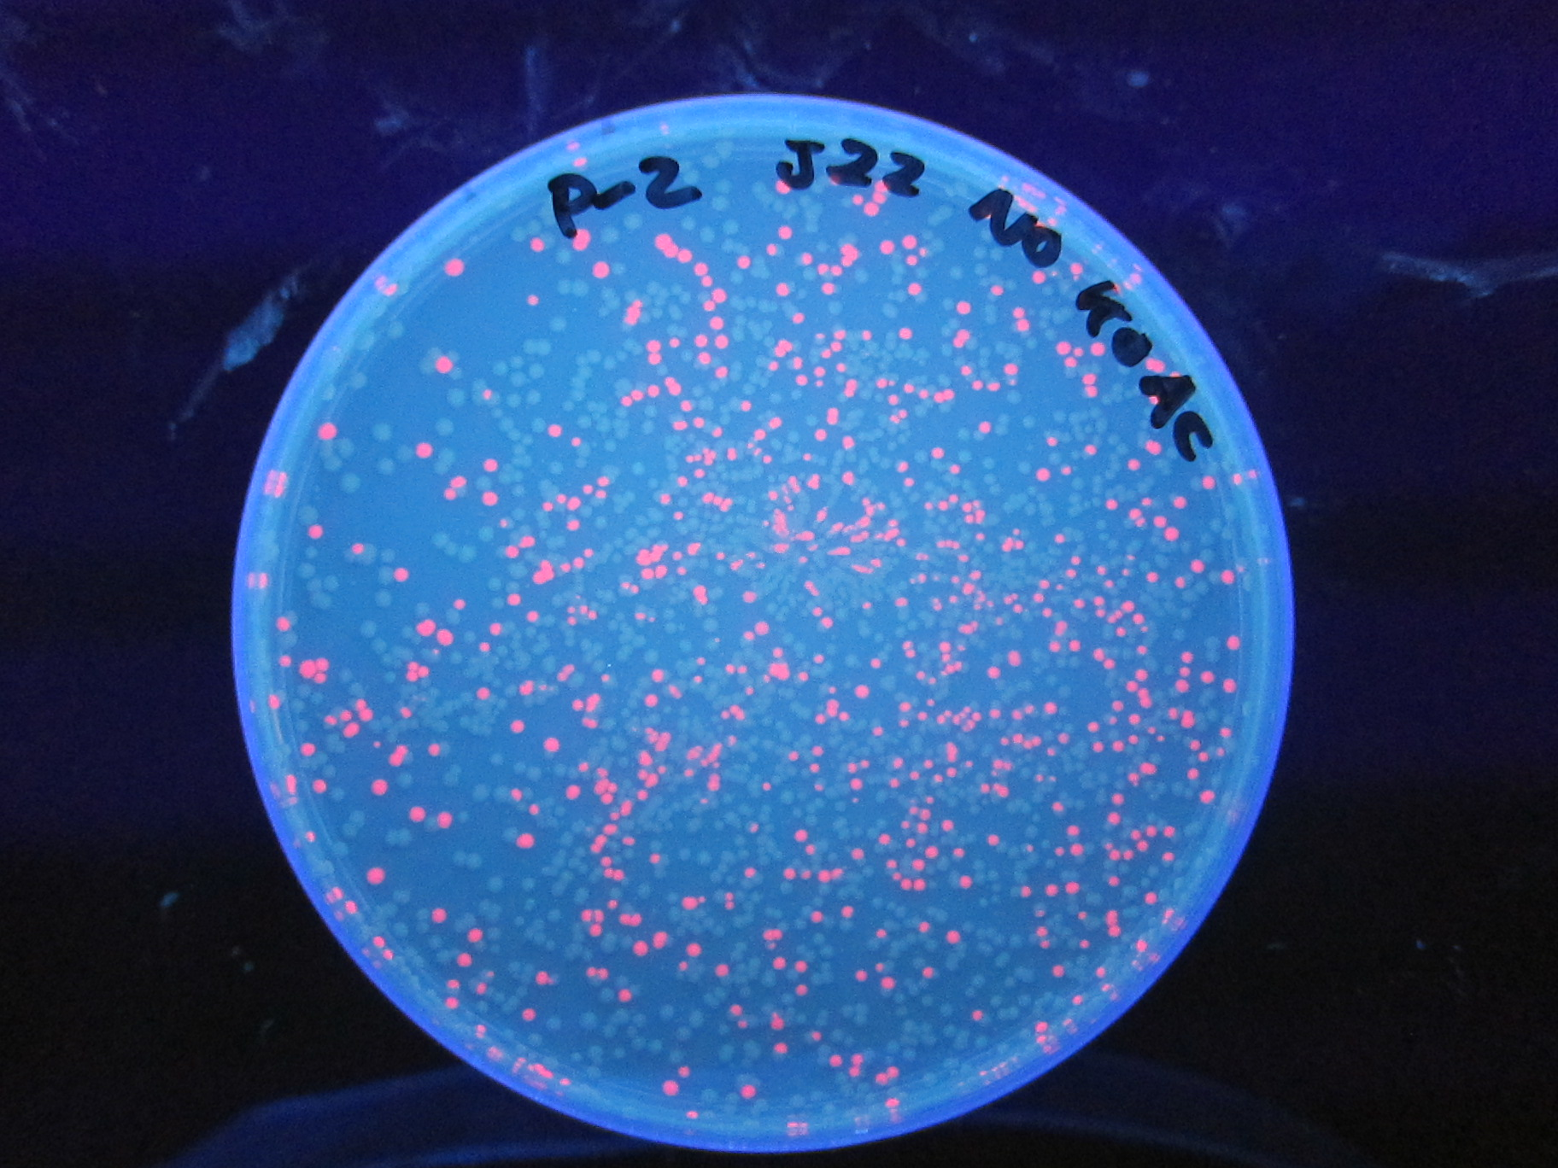
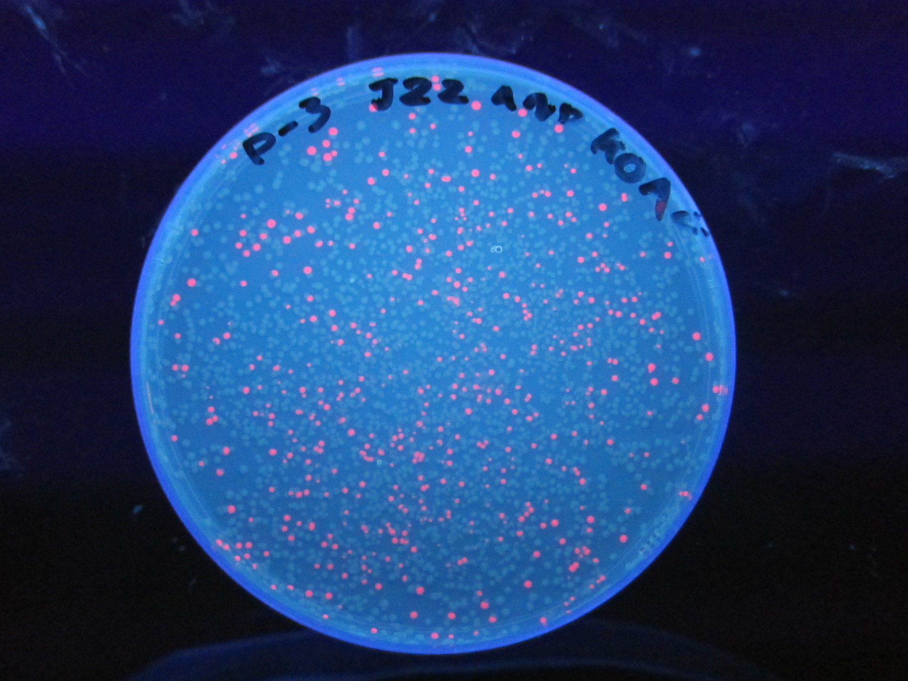
Presence of KOAC

Slide 30
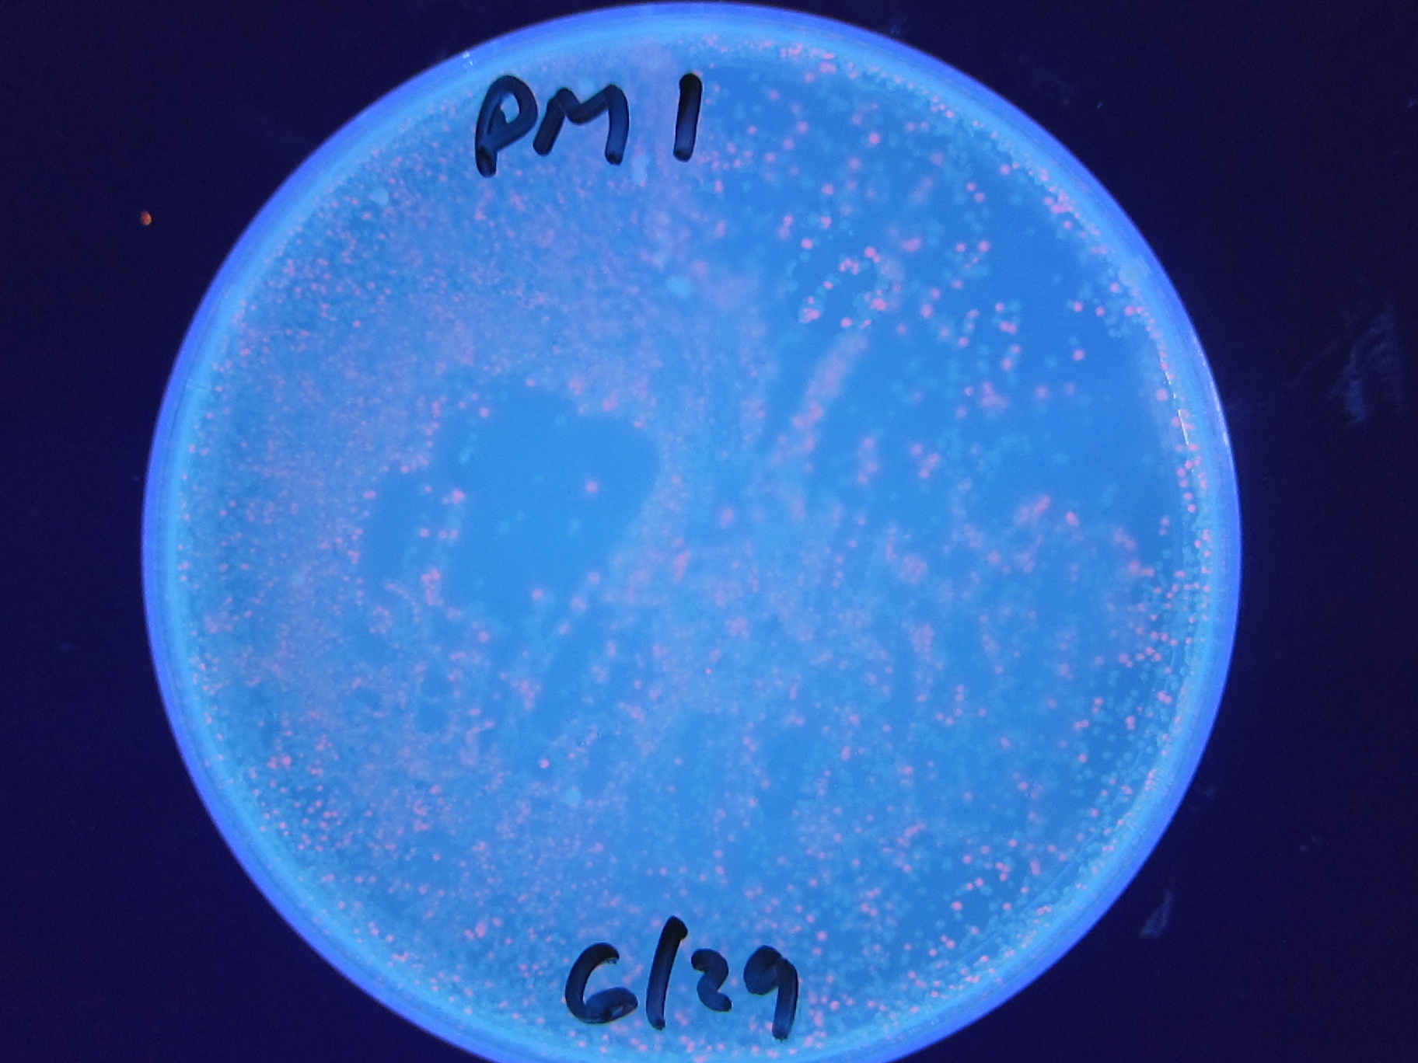
Plasmid Medley

Slide 31
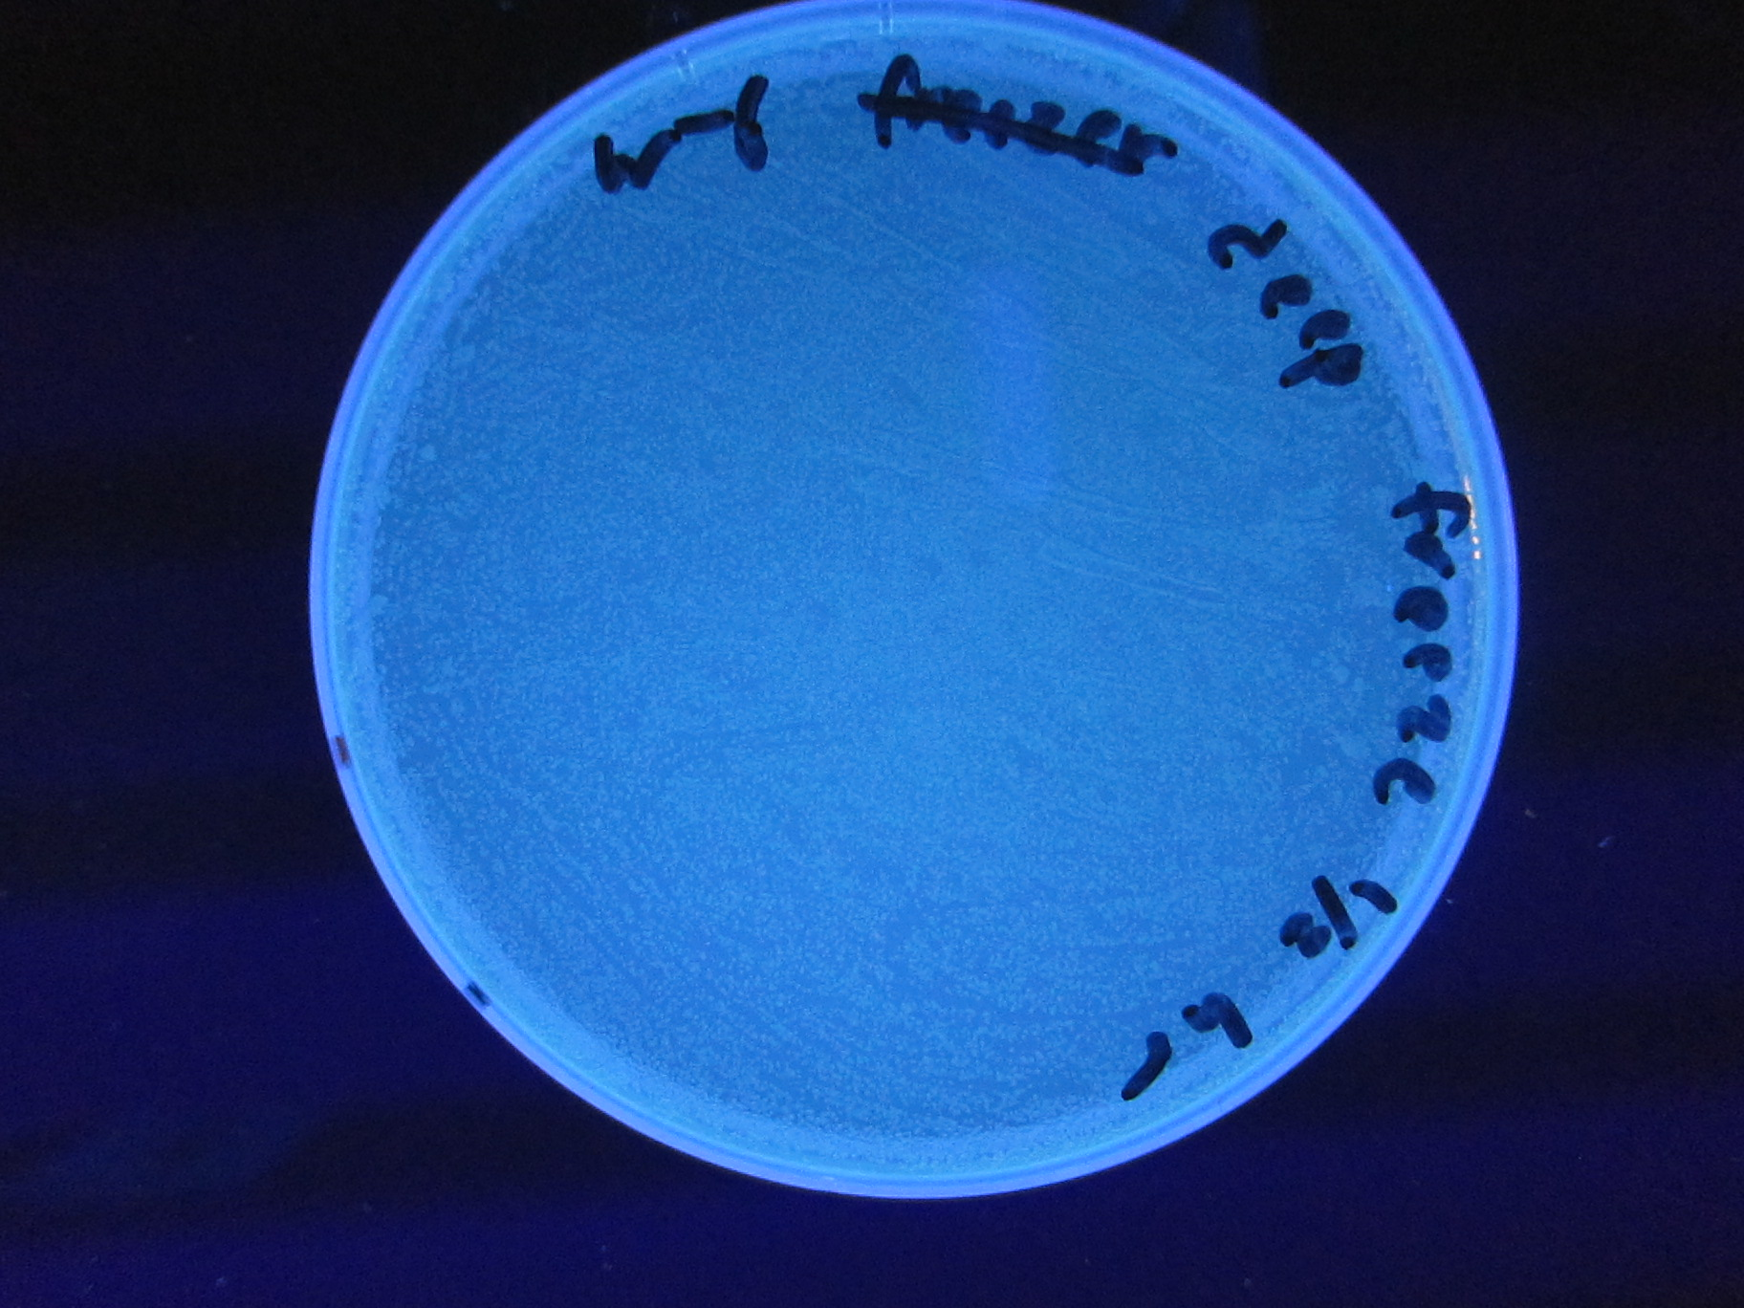
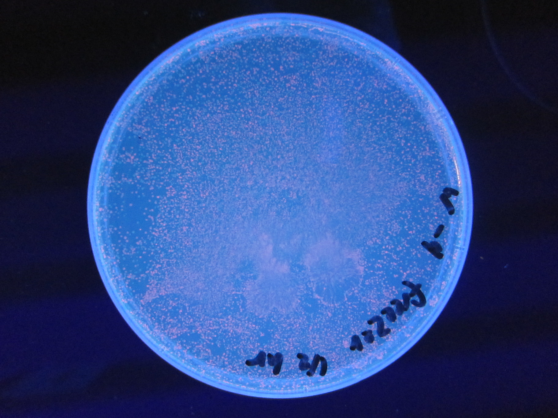
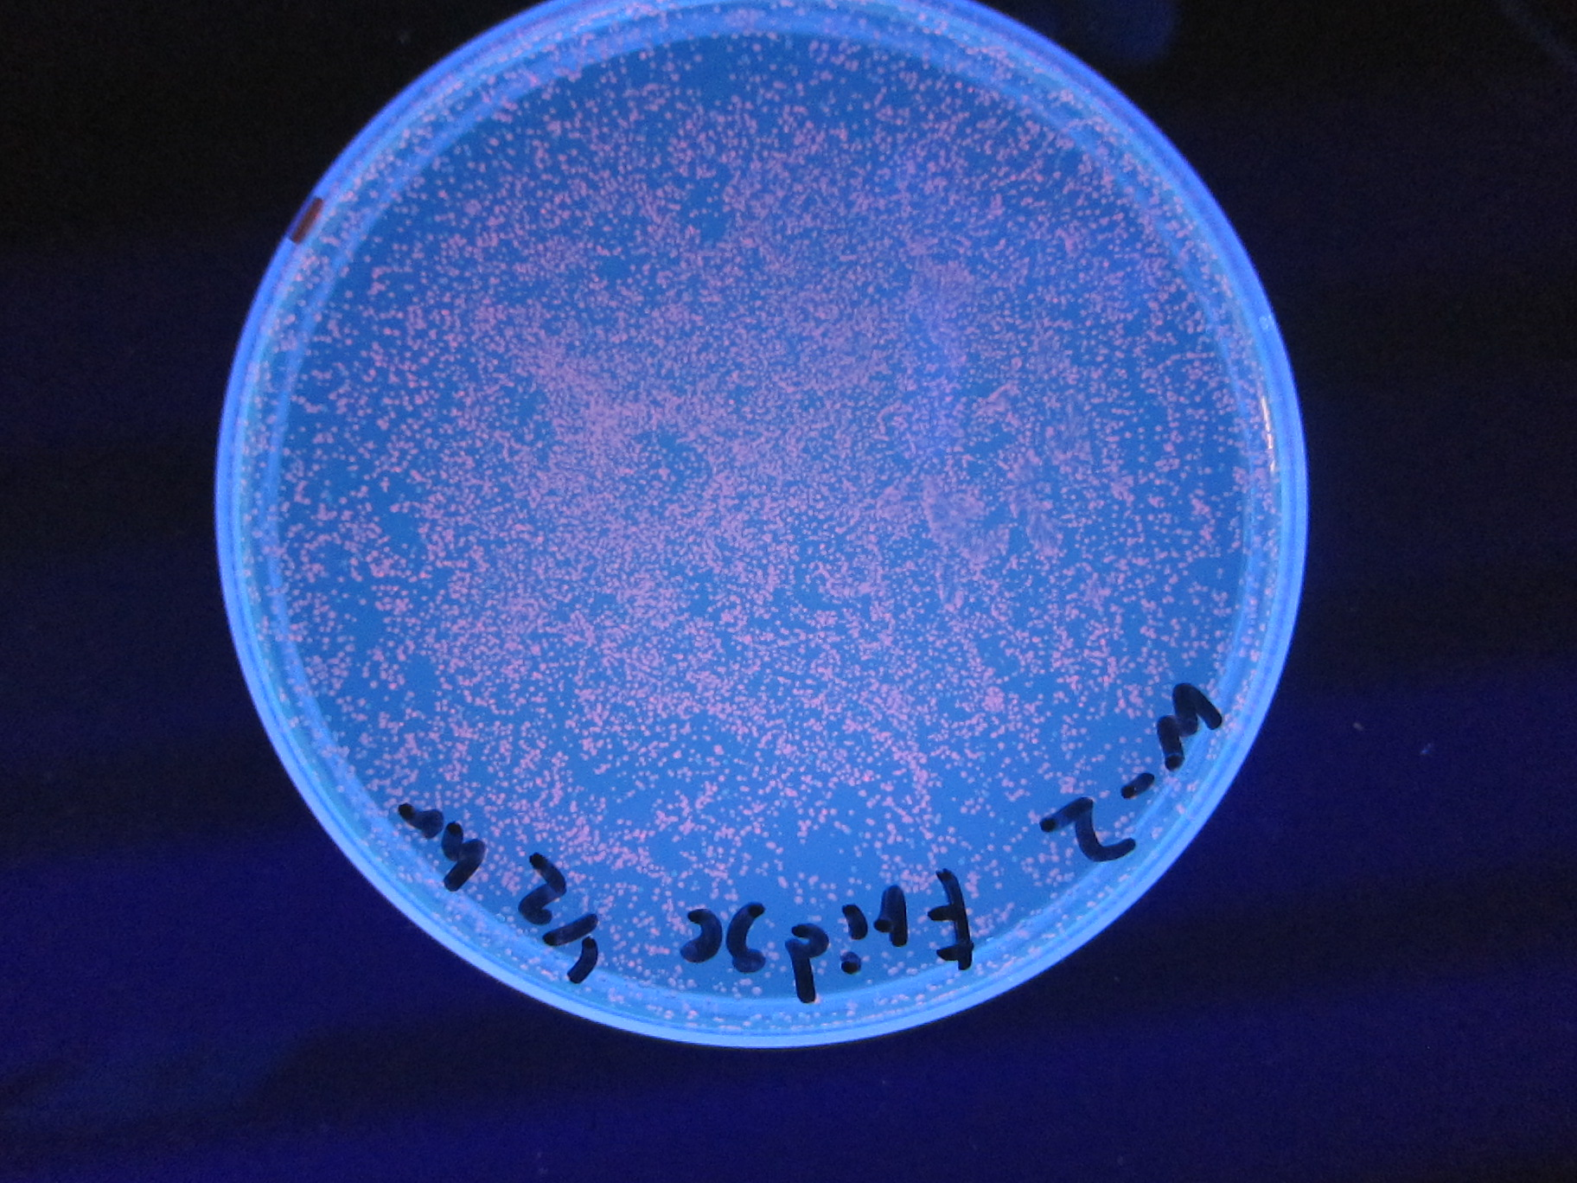
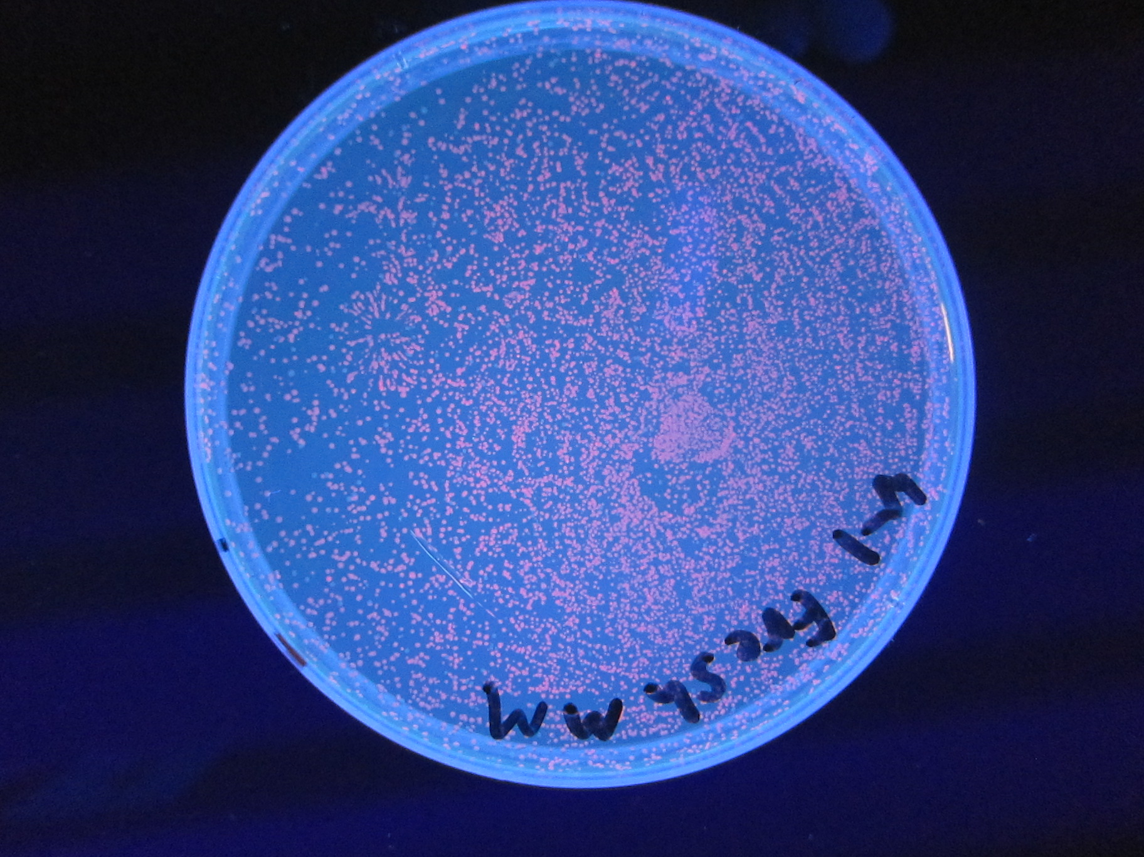
Robustness of the Master Mix (sans KOAC)

